Slide 1
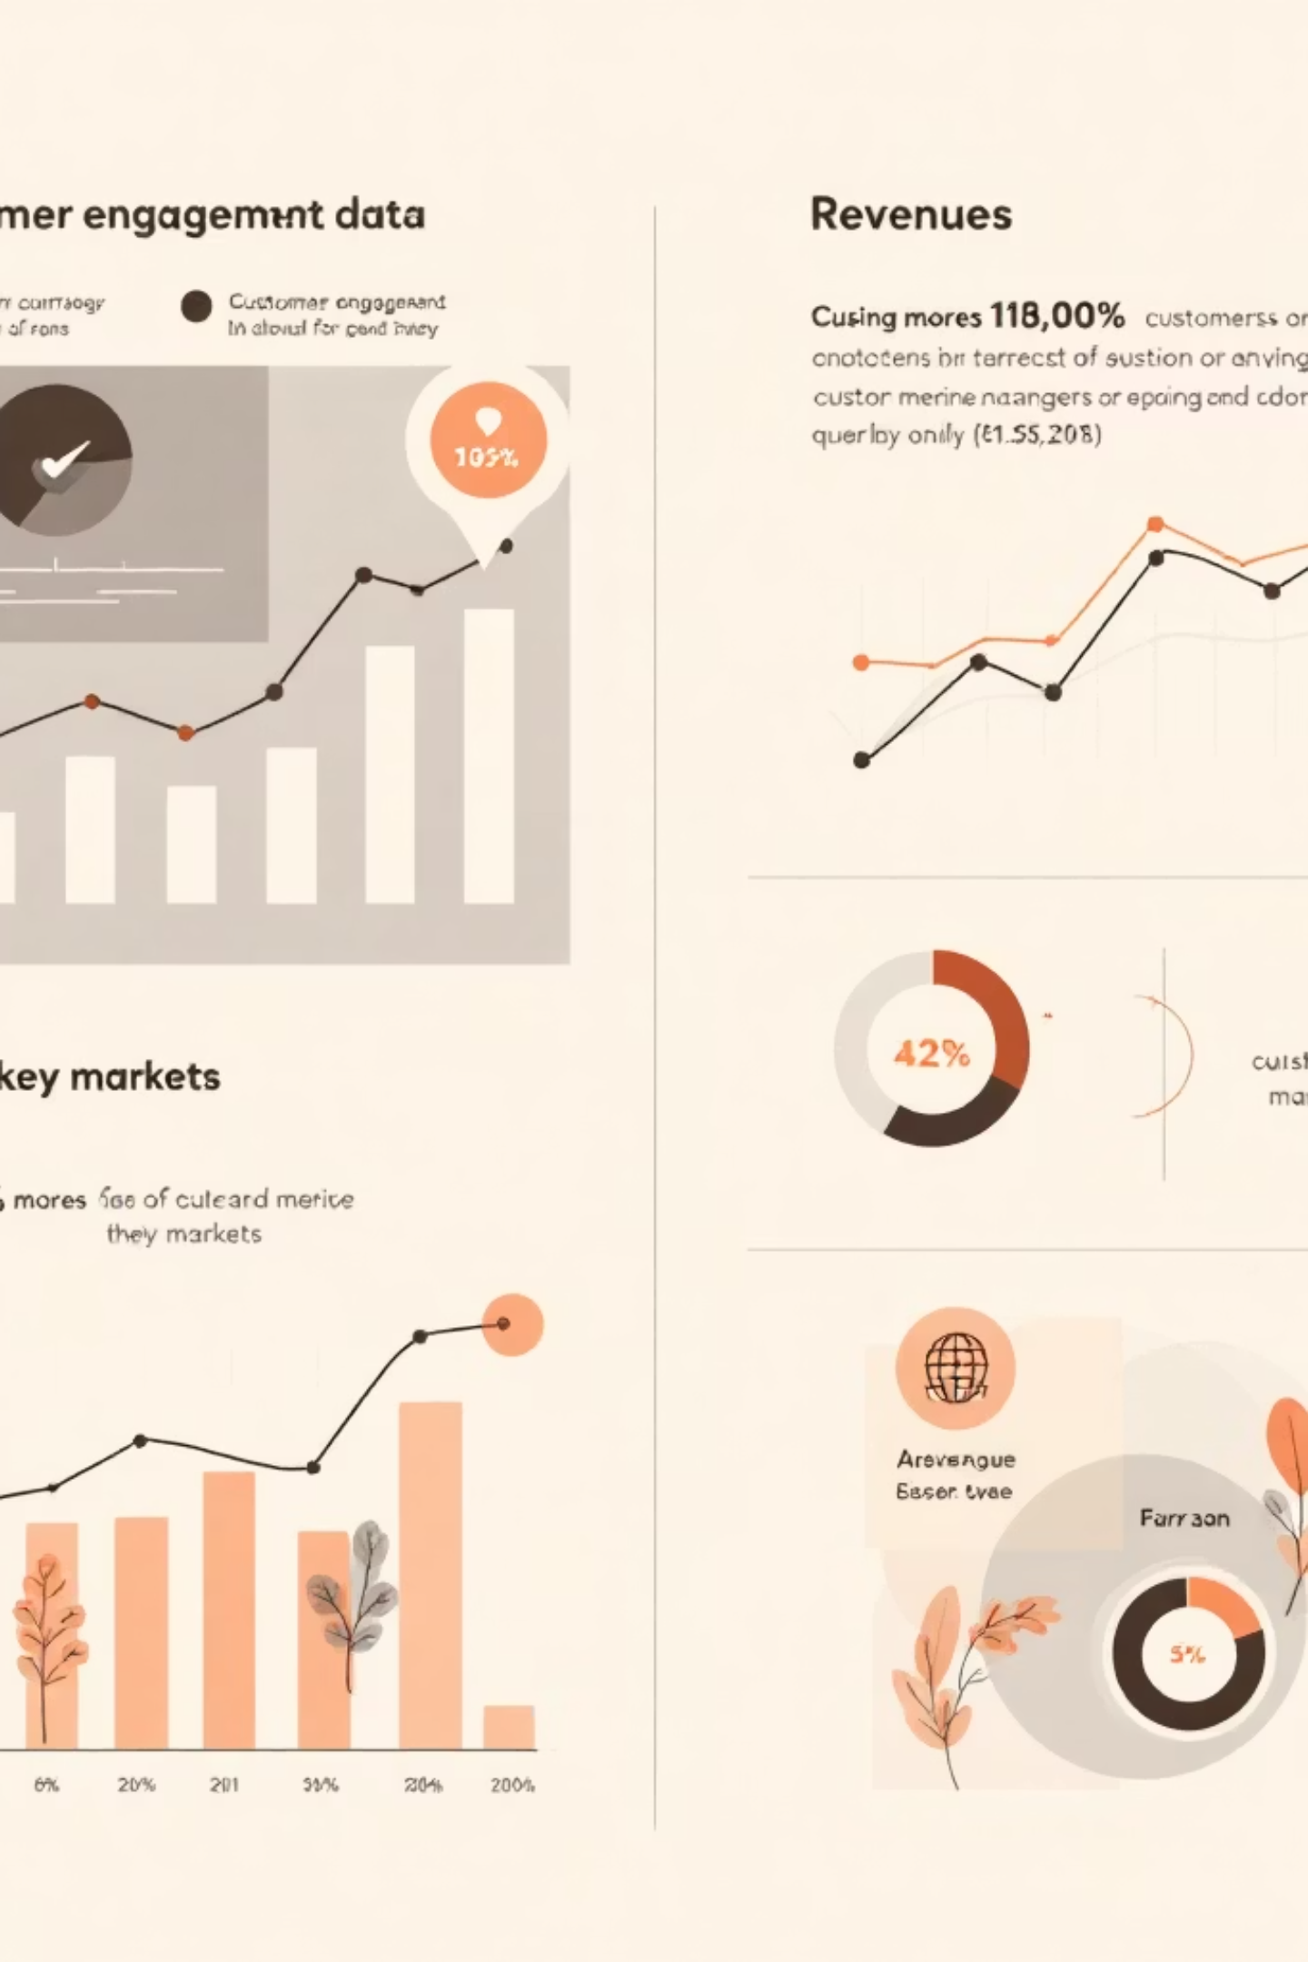
Diagnosing Revenue Leakage & Customer Drop-off in an E-Commerce Marketplace
By Shivam Dhunotiya

Slide 2
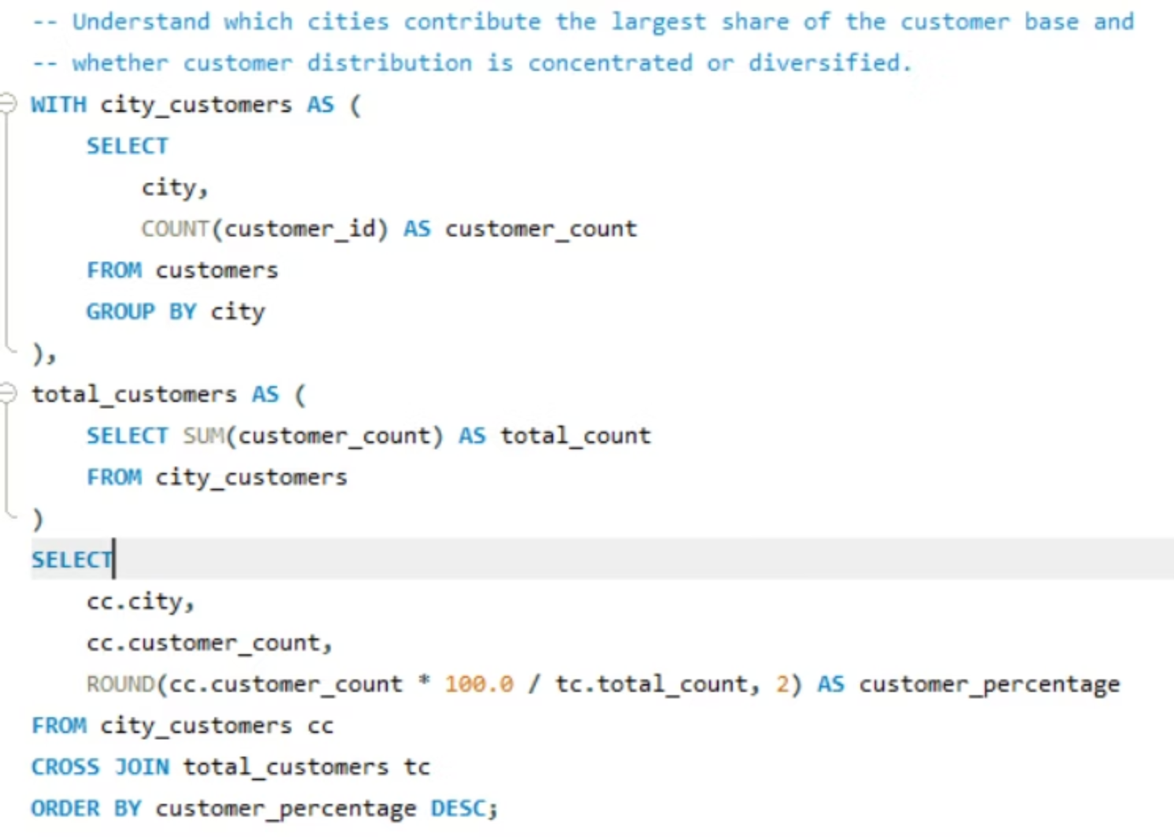
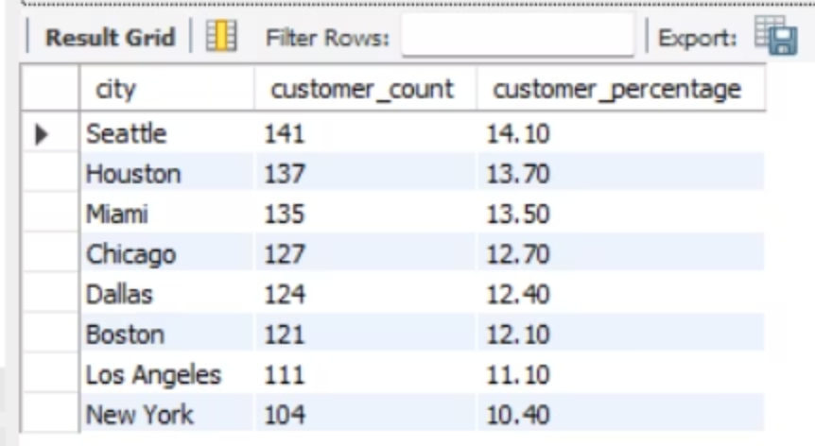
ANALYSIS
Geographic Distribution: Balanced Market Presence
Well-Diversified Base
Balanced Penetration
Reduced Risk
Each city contributes 10-14% of total customers
No single city dominates the customer base
Geographic diversity minimizes dependency on any one market

Slide 3
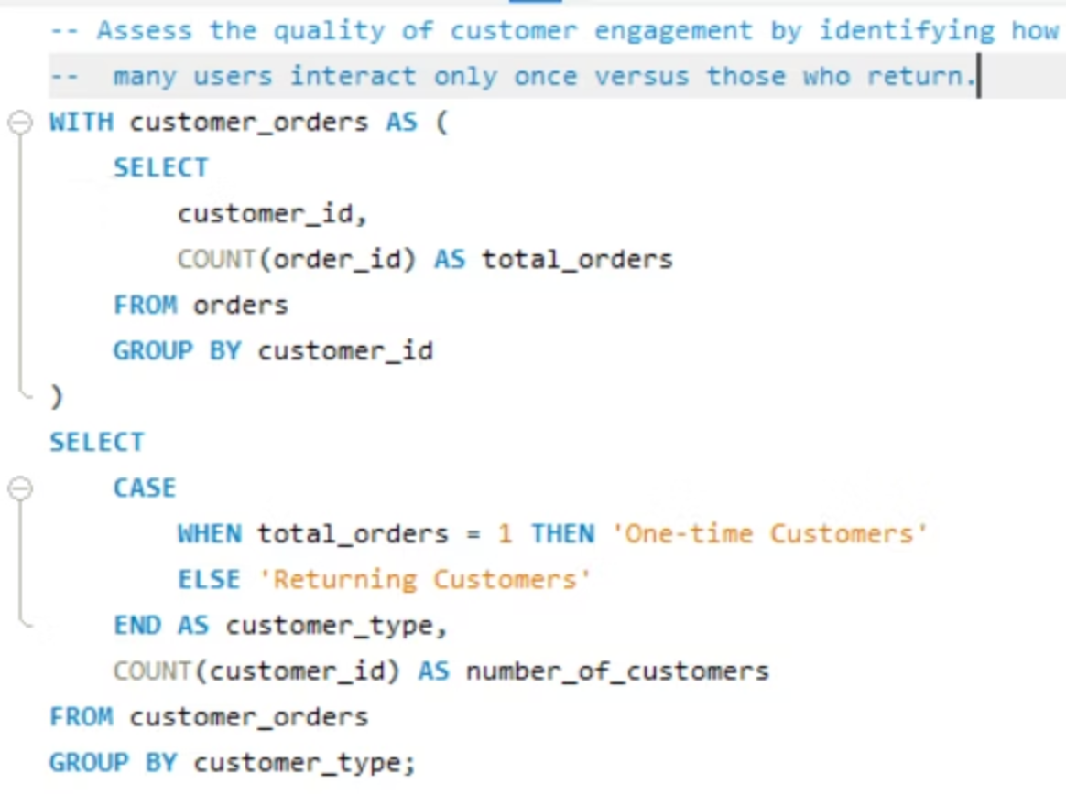
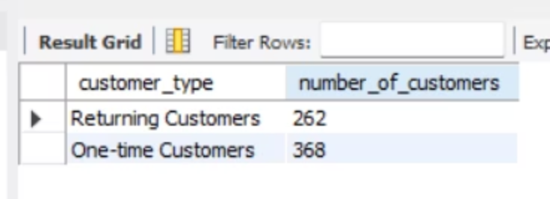


ANALYSIS
Customer Engagement: Retention Opportunity
This indicates moderate engagement quality with significant scope for improving customer retention.
Single Interaction
Repeat Purchases
58%
42%
Users engage only once
Return for multiple transactions
Key Finding: Moderate engagement quality with significant scope for improving customer retention strategies

Slide 4
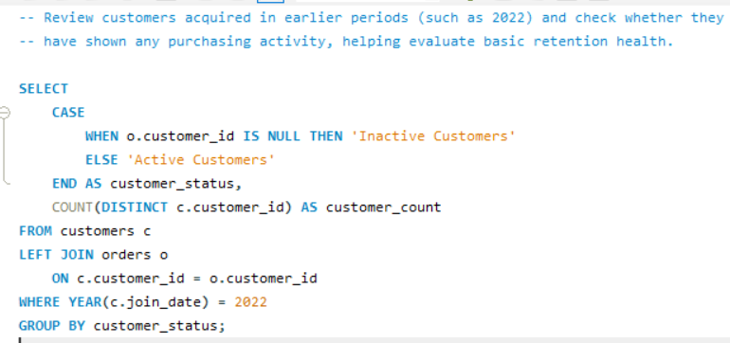
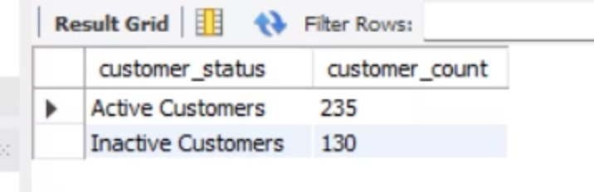
ANALYSIS
Purchase Activity: Active vs. Inactive Customers
1
2
Active Purchasers
Inactive Users
64% demonstrate purchasing activity
36% remain without purchases
Indicates moderate retention health
Opportunity to improve early engagement

Slide 5
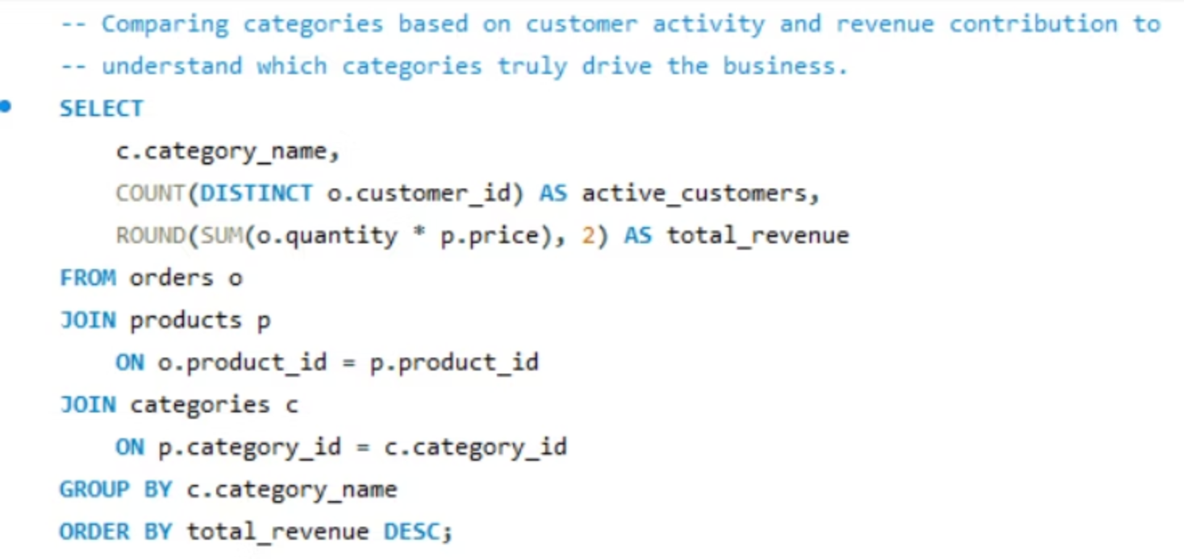
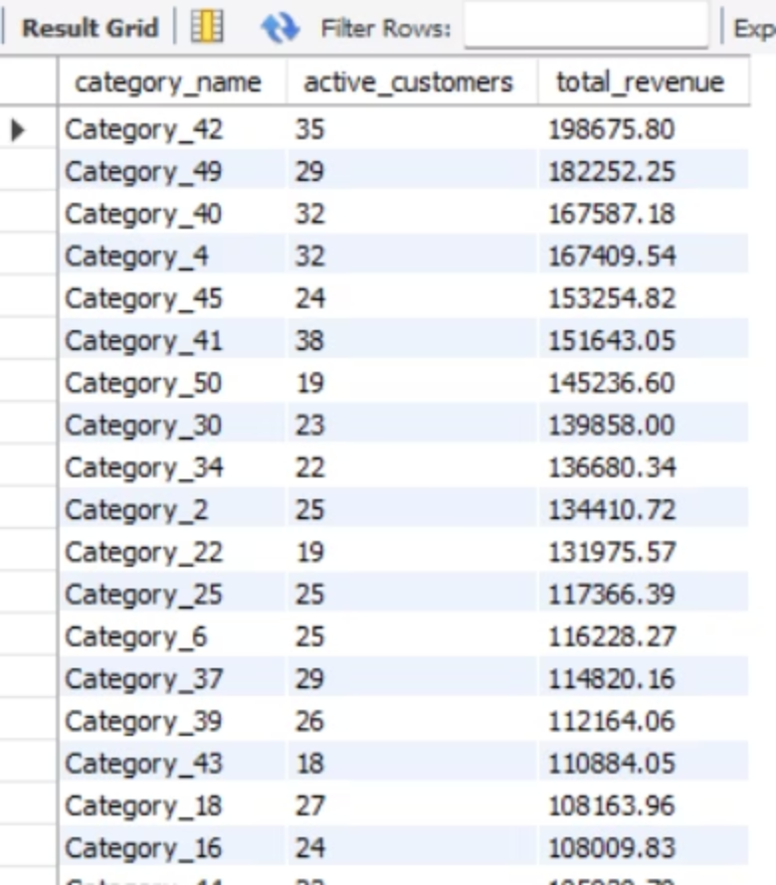



CATEGORY ANALYSIS
Category Performance: Revenue & Engagement Dynamics
Primary Drivers
Risk Categories
Growth Potential
Category_42, Category_49: strong revenue + high engagement
Category_50: good revenue but fewer customers (churn risk)
Category_41: moderate revenue, high engagement (38 customers)

Slide 6
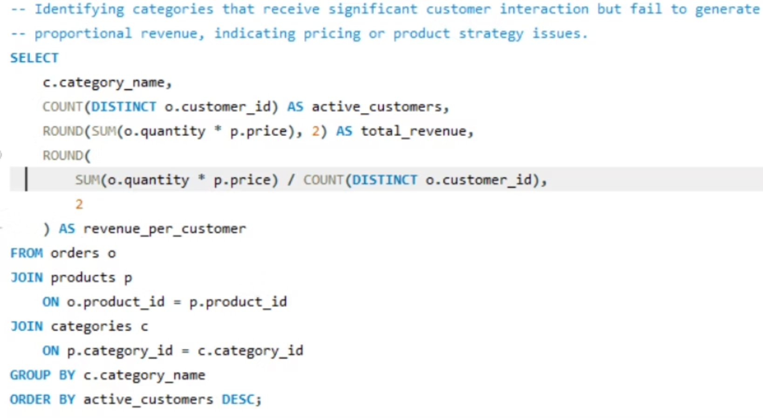
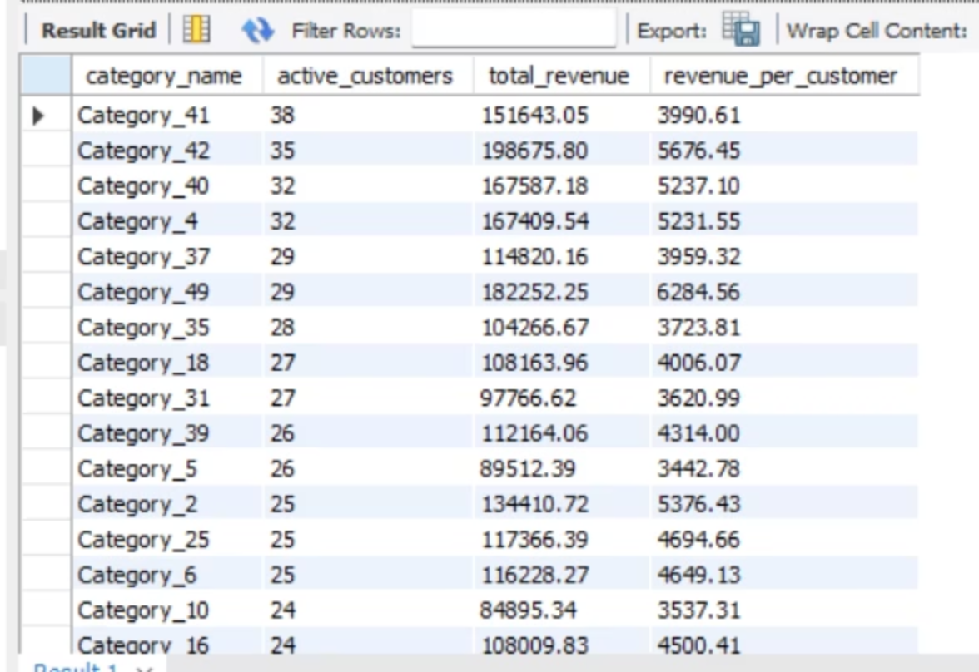


CATEGORY ANALYSIS
Monetization Efficiency: Engagement vs. Revenue
Under-Monetized
Key Drivers
Category_41, Category_37, Category_35
Category_49, Category_42, Category_45
High interaction, lower revenue conversion
Effectively convert engagement into revenue

Slide 7
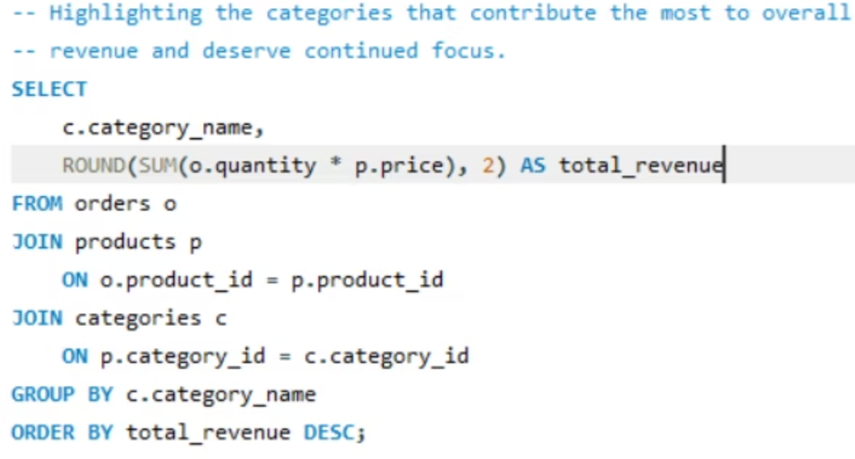
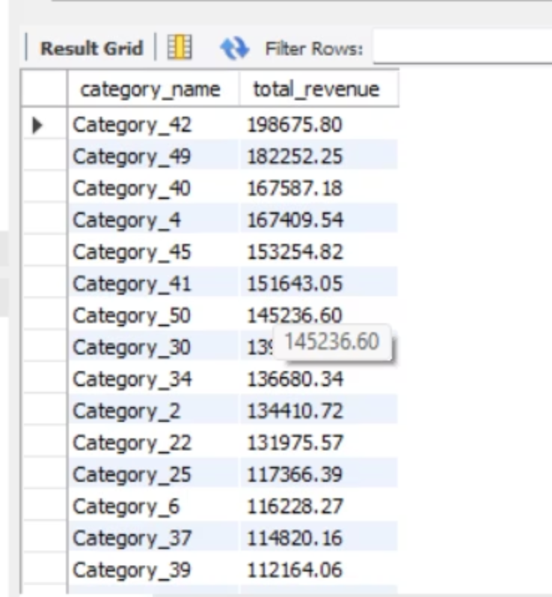
CATEGORY ANALYSIS
Revenue Contribution: Strategic Focus Areas
Category_42, Category_49, Category_40, and Category_4 contribute the largest share of overall revenue
01
02
03
Inventory Management
Marketing Investment
Product Expansion
Prioritize stock levels for top performers
Focus campaigns on revenue drivers
Develop offerings within high-performing categories

Slide 8
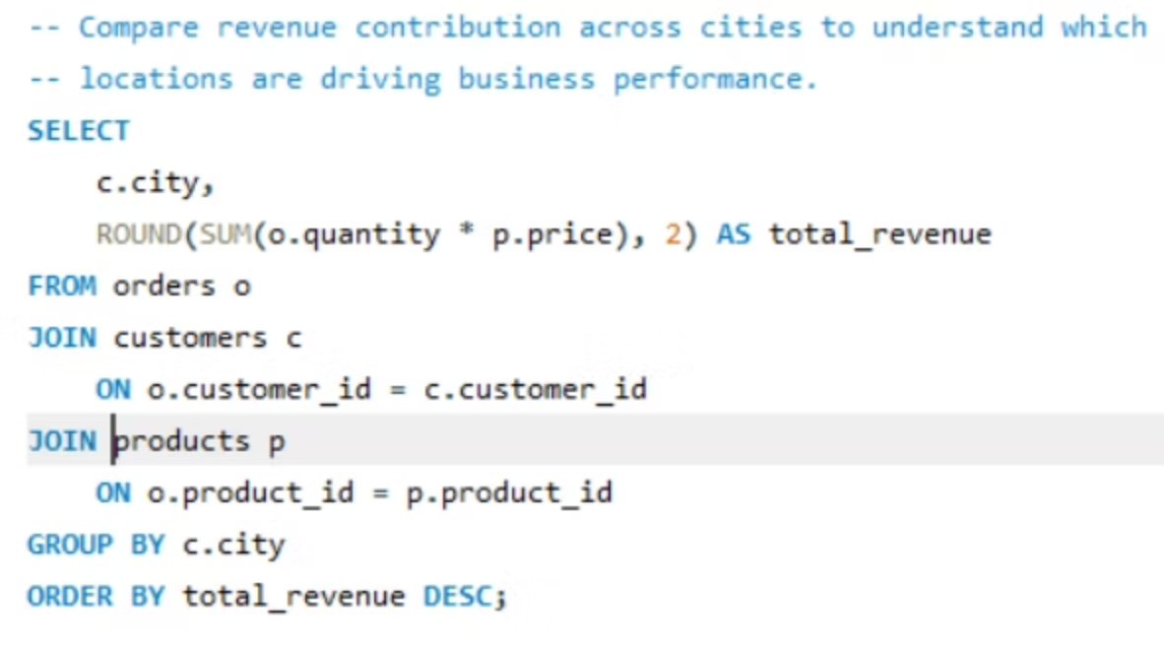
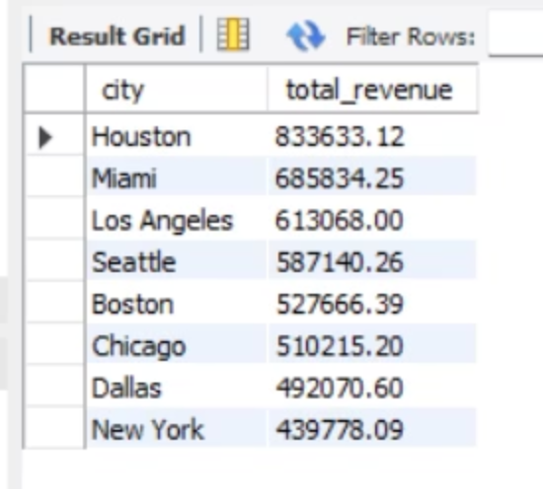
CITY REVENUE ANALYSIS
Geographic Revenue Performance
Top Performers
Growth Opportunities
Houston, Miami, Los Angeles drive largest revenue share
New York, Dallas: potential for targeted initiatives
1
2
3
Stable Support
Seattle, Boston, Chicago provide consistent performance

Slide 9
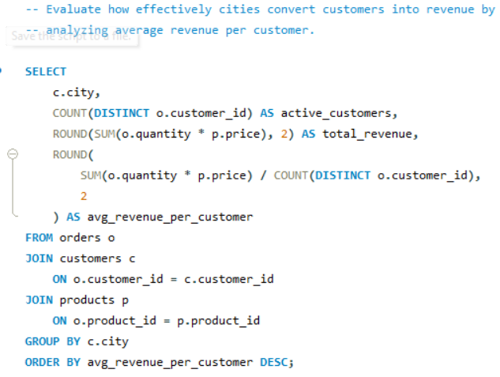
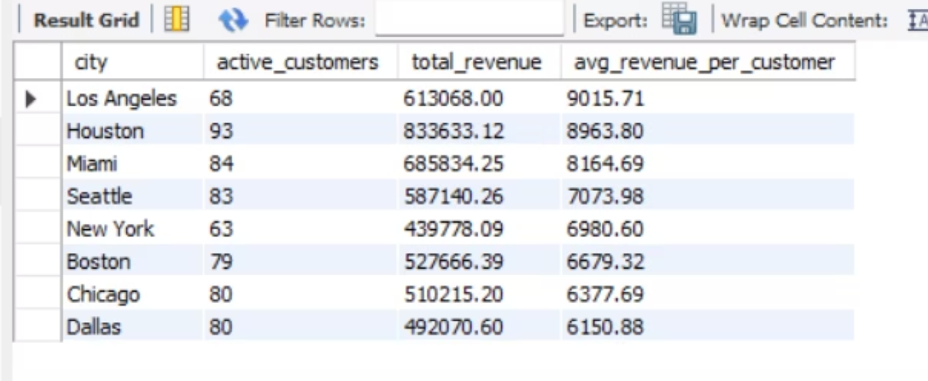

REVENUE EFFICIENCY
Customer Monetization by City
High Conversion Markets
Los Angeles, Houston, Miami achieve highest average revenue per customer
Monetization Gaps
Dallas, Chicago: healthy volumes but lower spend per customer
Strategic Insight: Cities like Dallas and Chicago show relatively low average revenue despite high customer volumes, indicating pricing or engagement inefficiencies

Slide 10
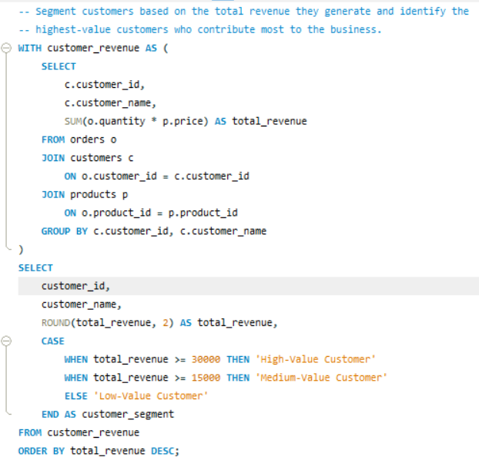
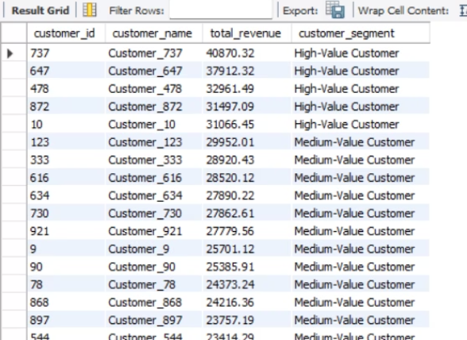
STRATEGIC RECOMMENDATIONS
High-Value Customer Strategy
High- Value Customers
Customers spending $30,000+ drive maximum revenue
Implement loyalty programs
Priority support access
Personalized offers

Slide 11
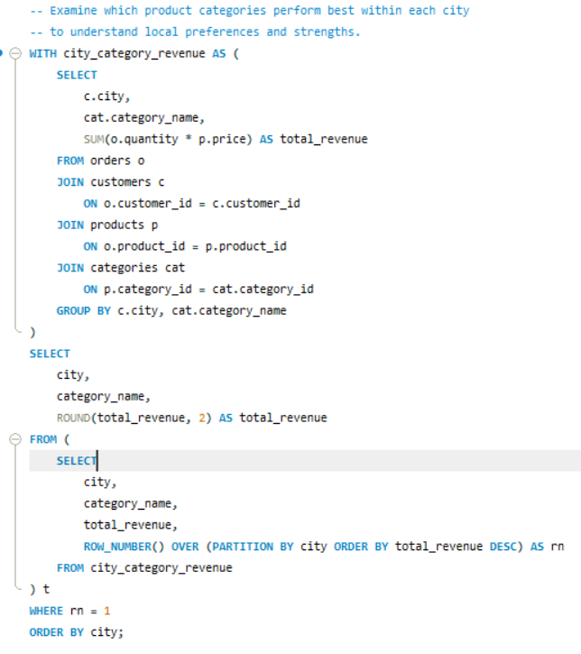
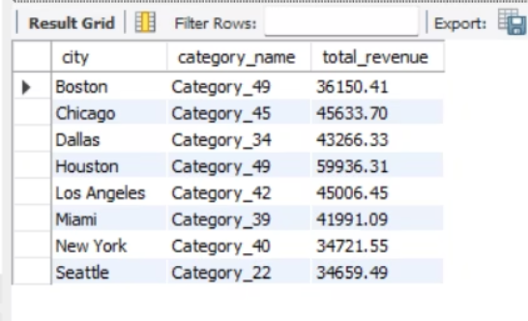
STRATEGIC RECOMMENDATIONS
Market Insights
Localized Preferences
City-level category analysis reveals distinct patterns
Category_49 performs strongly in Boston and Houston, while other cities show unique leading categories reflecting local customer preferences

Slide 12
THANK YOU

